Slide 1
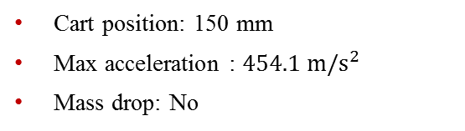
Datasets
High-Rate Overview
Benchmark
Applications
Datasets
Dataset 5 – test 18
Excitations:
Static cart action
Single hammer impact
Electromagnet mass
Cart position: 150 mm
Max acceleration : $454.1 m/s^{2}$
Mass drop: No

Slide 2
Datasets
High-Rate Overview
Benchmark
Applications
Datasets
Dataset 5 – test 18
Excitations:
Static cart action
Single hammer impact
Electromagnet mass
Cart position: 150 mm
Max acceleration : $454.1 m/s^{2}$
Mass drop: No

Slide 3

Datasets
High-Rate Overview
Benchmark
Applications
Datasets
Dataset 5 – test 19
Excitations:
Static cart action
Single hammer impact
No electromagnet mass
Cart position: 200 mm
Max acceleration : $1315 m/s^{2}$
Mass drop: N/a

Slide 4
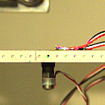
Datasets
High-Rate Overview
Benchmark
Applications
Datasets
Dataset 5 – test 19
Excitations:
Static cart action
Single hammer impact
No electromagnet mass
Cart position: 200 mm
Max acceleration : $1315 m/s^{2}$
Mass drop: N/a

Slide 5

Datasets
High-Rate Overview
Benchmark
Applications
Datasets
Dataset 5 – test 20
Excitations:
Static cart action
Single hammer impact
No electromagnet mass
Cart position: 200 mm
Max acceleration : $1191 m/s^{2}$
Mass drop: N/a

Slide 6
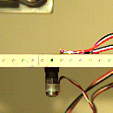
Datasets
High-Rate Overview
Benchmark
Applications
Datasets
Dataset 5 – test 20
Excitations:
Static cart action
Single hammer impact
No electromagnet mass
Cart position: 200 mm
Max acceleration : $1191 m/s^{2}$
Mass drop: N/a

